Slide 1


FY 2019-20
The economic value of
Iowa's Community Colleges
ANALYSIS OF THE ECONOMIC IMPACT
AND RETURN ON INVESTMENT OF EDUCATION

Slide 2
Emsi Burning Glass & Community Colleges
20+ years working with higher education institutions
2,200+ economic impact studies completed
2M students used Emsi Burning Glass’ career pathways tool in 2020
7 of 10 2021 Aspen Prize finalists received Emsi Burning Glass economic impact studies
10 of 10 2021 Aspen Prize finalists are Emsi Burning Glass customers

Slide 3


What is an
ECONOMIC IMPACT ANALYSIS?
Measures how an event or institution affects the local economy
What is an
INVESTMENT ANALYSIS?
A comparison of the costs and benefits to determine the return on investment

Slide 4
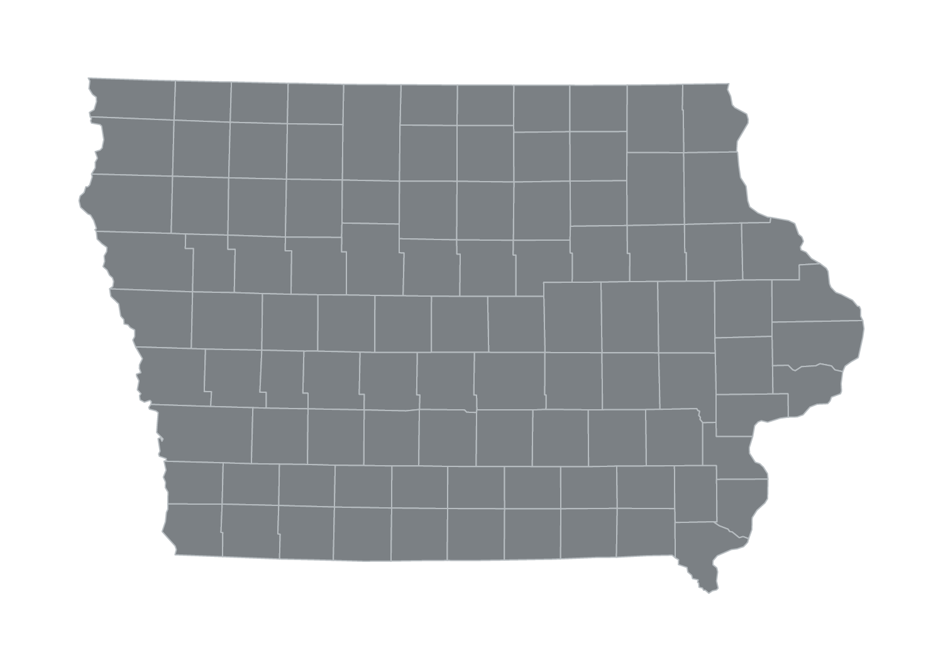
About Iowa
Average earnings by education level
< HS
$22,400
HS
$30,100
Certificate
$33,800
Associate
$38,000
Bachelor's
$51,000
$172.5 billion
2,032,904
Total Gross Regional
Product (GRP)
Total Jobs

Slide 5
Iowa's Community Colleges in FY 2019-20
127,013
145,814
Credit students served
Non-credit students served
$508.6 million
11,744
Total payroll/benefits
Employees
$193.4 million
4%
Total tuition revenue
Students from outside the region

Slide 6
Overview of results
$5.5 billion
6.3
Total income added to the state
Benefit-cost ratio for students
3.2%
2.5
Of state’s GSP
Benefit-cost ratio for taxpayers
87,149
8.6
Total jobs supported in the state
Benefit-cost ratio for society

Slide 7


Operations
Spending Impact
ECONOMIC IMPACT ANALYSIS
Construction
Spending Impact
College payroll and
other spending + ripple effects
College construction
expenditures + ripple effects
$519 million
$23.9 million
Added state income
Added state income
OR
OR
11,631
352
Jobs supported in the state
Jobs supported in the state
All results measured in income, not sales. Results are net of counterfactual scenarios.

Slide 8


ECONOMIC IMPACT ANALYSIS
Student
Spending Impact
Alumni
Impact
Relocated/retained student
spending + ripple effects
Higher alumni earnings and increased
business profit + ripple effects
$181.2 million
$4.8 billion
Added state income
Added state income
OR
OR
3,936
71,230
Jobs supported in the state
Jobs supported in the state
All results measured in income, not sales. Results are net of counterfactual scenarios.

Slide 9
ECONOMIC IMPACT ANALYSIS
Total Impact
$5.5 billion
Impacts by industry (jobs supported)
Total income added
in the state
OR
3.2%
Of state’s GRP
87,149
Total jobs supported
in the state
OR
1
out
of
23
jobs in the state

Slide 10



INVESTMENT ANALYSIS
Student
Perspective
Taxpayer
Perspective
Social
Perspective
$4 billion
$1.1 billion
$11.9 billion
Benefit: Higher future earnings
Benefit: Future tax revenue,
government savings
Benefit: Future earnings,
tax revenue, private savings
$626.2 million
$424.6 million
$1.4 billion
Cost: Tuition, supplies, opportunity cost
Cost: State and local funding
Cost: All college and student costs
6.3
2.5
8.6
Benefit/cost ratio
Benefit/cost ratio
Benefit/cost ratio
24.9%
n/a*
Rate of return
Rate of return
Rate of return
Future benefits are discounted to the present.
* The rate of return is not reported for the social perspective because the beneficiaries are not necessarily the same as the original investors.

Slide 11
Next Steps
Share
results with
state media.
Share
industry impacts with business partners.
Send the
executive
summary to state legislators.
Use campus fliers, newsletters, & websites to
publish results.
Use social media
to broadcast student returns to prospective students and
parents.
Leverage impacts
for proposals, grant writing, & strategic planning.
HOW CAN
EMSI BURNING GLASS HELP?
Emsi Burning Glass’ press
packet
Ongoing presentations from your Emsi Burning Glass economist
Email/call
us anytime

Slide 12
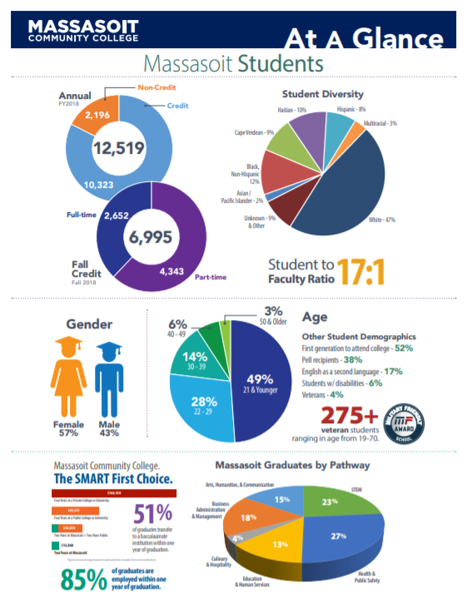
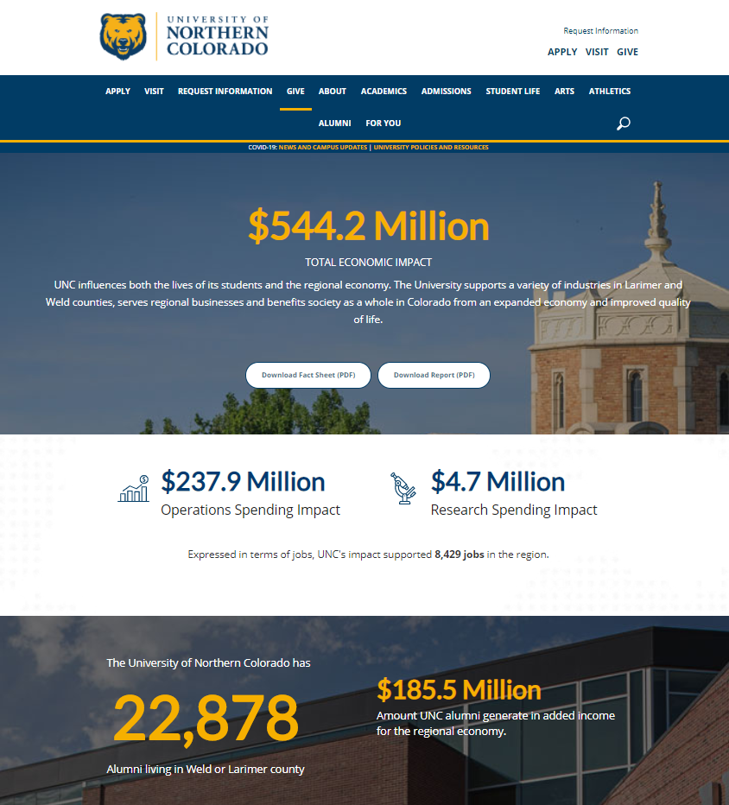

Share your results
Combine your results
with other institutional highlights to create a
fact sheet.
Create a web page that includes written highlights, animations, and videos.
Include your results in your periodic publications.

Slide 13
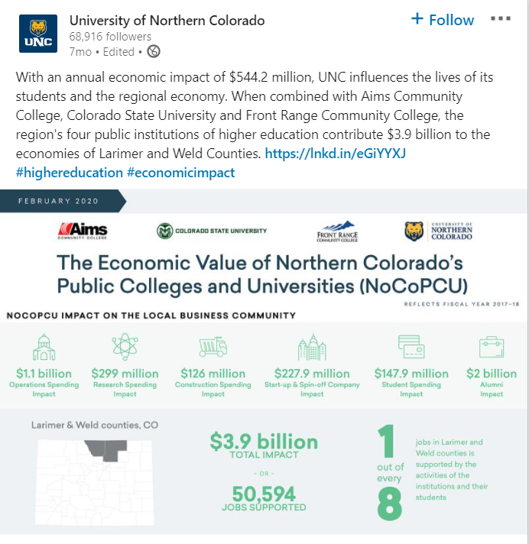
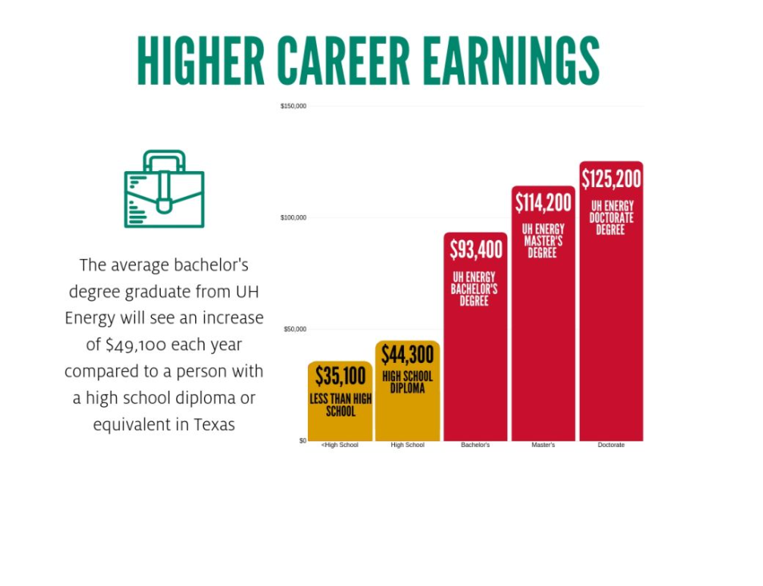
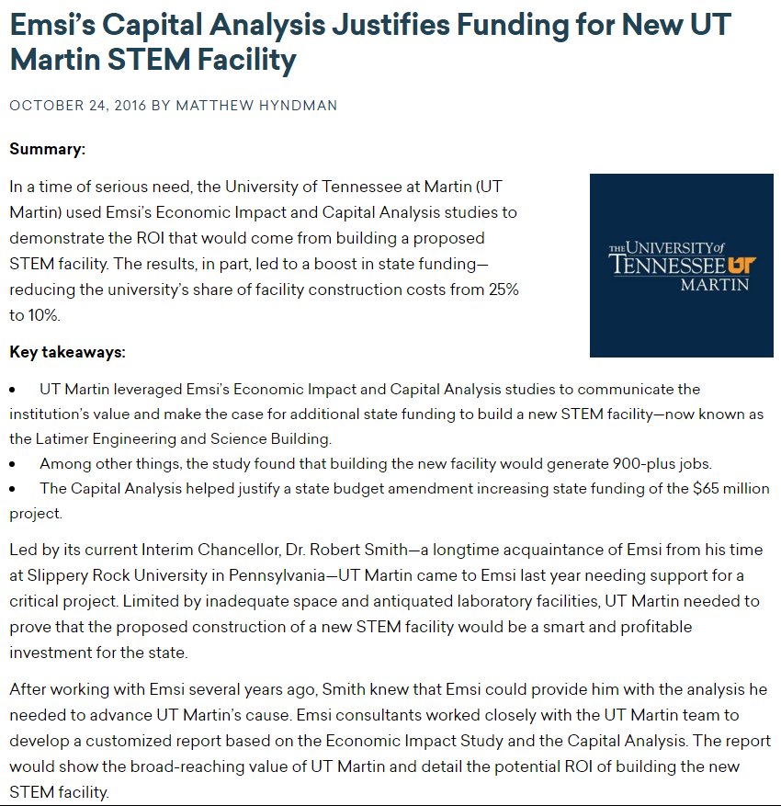
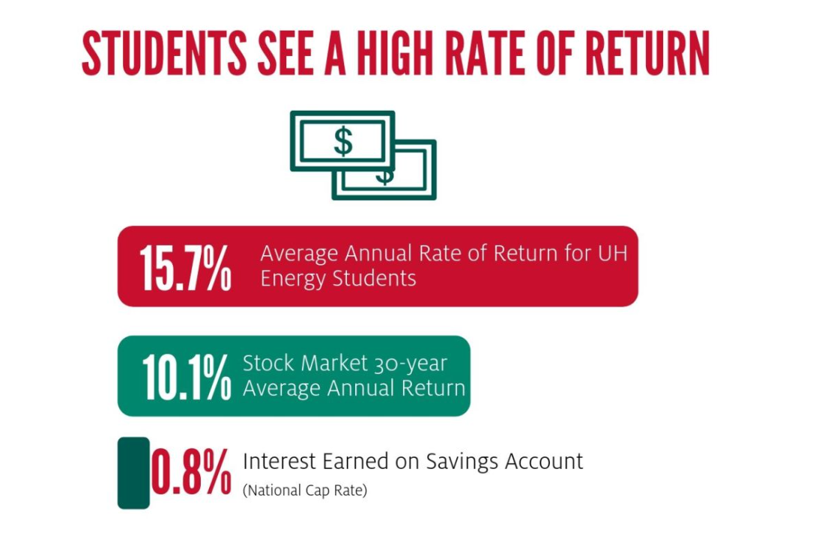
Share your results
Create a press release or hold a press conference to share results with your state and local media.
Use social media to share your investment results with prospective students.
Use your study to help secure additional funding.

Slide 14

The results of this study
were prepared by
For a copy of the report, please contact Iowa's Community Colleges.

